Slide 1
FALL Semester OPEN HOUSE: team 8D
HENDERSON middle school 2020-2021

Slide 2
Welcome
Ms. Tony Magness
Mrs. Patricia Allen-Threat
Mr. Franklin Lopez
Mr. Robert Poff
Mr. Reygan Reed

Slide 3
About us
Mrs. Magness - Inter-Related
Mr. Lopez – Social studies
Mr. Robert Poff – Math
Mr. Reygan Reed – English language arts
Mrs. Patricia Allen-threat – SCIENCE

Slide 4
Administrative and counseling support
Ms. Rochelle Patillo– Principal
Mr. Jarron Worlds – 8th Grade administrator
Dr. Angela Coleman– 8th Grade Counselor

Slide 5
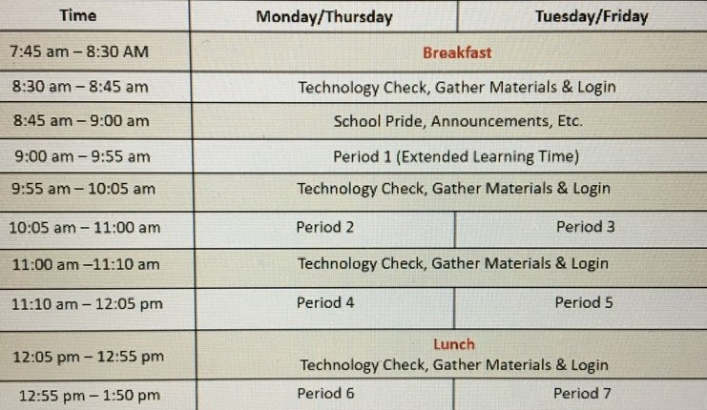
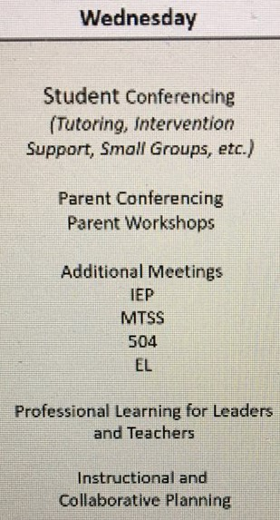
Class schedule

Slide 6
Team rules
Follow directions the first time they are given.
Come to class prepared and on time.
Respect yourself and others.
Raise your hand to speak or get out of your seat.
Refrain from eating, drinking, or chewing gum in class.

Slide 7
Consequences
Warning
Student/Teacher Conference
Parent Contact – Telephone
Detention (On Team/After school)
Student/Parent/Teacher Conference
On Team Detention
Administrator Referral
(Please refer to the STUDENT CODE OF CONDUCT FOR FURTHER DETAILS)

Slide 8
Rewards
Pleasant and positive learning environment
8D BUCKS (Face to face)
Satisfactory conduct on progress report
Positive recommendations for extra-curricular activities
Opportunities to attend field trips/Activities
Avoiding disciplinary consequences

Slide 9
Student responsibilities
Attend
Attend online classes/be PREPARED.
COMPLETE
COMPLETE ALL ASSIGNMENTS BY DUE DATES/DEADLINES.
MAKE UP
MAKE UP MISSING/INCOMPLETE ASSIGNMENTS (it's your RESPONSIBILITY).
DO
DO YOUR BEST-ALWAYS!
ASK
ASK FOR HELP IF YOU NEED ASSISTANCE.

Slide 10
Tentative field trips
Mercedes Benz Stadium
CNN Center
*Dekalb History Museum
IFLY
*Six Flags
Civil and Human Rights Museum
*Space Camp-Huntsville
*Savannah

Slide 11
STEM/STEAM ACTIVITIES
MISSION TO MARS
STEM Wax Museum
Physical SCIENCE EXPLORATION
CATAPULT
CODING
MORE TBA

Slide 12
Additional Activities
Pizza parties
FUN FRIDAYS
TEAM DAYS
STUDENT SOCIALS

Slide 13
CHROMEBOOKS
REQUIRED
FREE FOR STUDENTS
INSURANCE MUST BE PURCHASED

Slide 14
INFINITE campus
RECOMMENDED FOR STUDENTS AND PARENTS

Slide 15
TEAM NEEDS
Tissue boxes
Hand sanitizer
Hand lotion
Stem supplies
Parent volunteers/chaperones
Team 8D STore contributions

Slide 16
TEAM PARENTS/SUPPORT
We COULDN'T do it without your support! THANK YOU!

Slide 17
Forms of Communication
Email
Teacher/class websites
Remind
Team email distribution list
Verge

Slide 18
SUPPLIES
SEE TEACHER SYLLABUS

Slide 19
Team wear
COMING SOON

Slide 20
Thank you FOR YOUR SUPPORT!
SIGN UP FOR THE PARENT EMAIL DISTRIBUTION LIST
SIGN UP FOR THE TEAM REMIND

