Slide 1
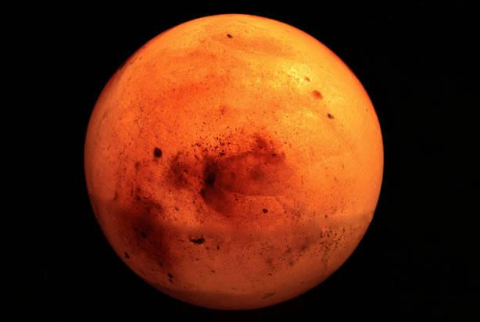
Mission to Mars
By; Tucker Phillips, Akil Malik, Michael Teklu, Stephanie Rodriguez and Savannah Bedinger

Slide 2
New World Colonizers
Crew Members:
John Anderson
Meredith Anderson
Roger Trudelle
Genevieve Garcia
Rebecca Johnson
Elijah Johnson
Miles Bernard

Slide 3
John anderson
JOHN ANDERSON
John Anderson is 43 years of age and has an I.Q. of 112. His health is good with some minor problems from smoking. He also has 15 years of successful farming under his belt. He could try to find ways to farm on Mars.
These are the reasons we picked John Anderson.

Slide 4
Meredith Anderson
Meredith is 13 with great health. She also has an I.Q. of 120. The reason we picked Meredith Anderson is because she can baby-sit the kids and has a positive outlook for them.

Slide 5
Roger trudelle
Roger is 27 with an I.Q. of 104. He can use his knowledge from working on an oil rig to explore the ice or soil on Mars.

Slide 6
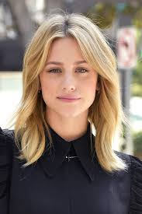
Genevieve garcia
Genevieve is 23 with an I.Q. of 105. She can help find a good place to sustain life. She can also help manage space to maximize storage on Mars.

Slide 7
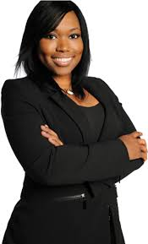
Rebecca johnson
Rebecca's health is good, her I.Q. is 142, and has a PhD in Computer Science. She can help with computers or electronics while the crew is on Mars.

Slide 8
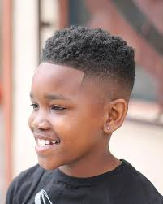
Elijah Johnson
Elijah Johnson is 8 years old and is in the 3rd grade. He has an outstanding IQ of 170 and has excellent health. We picked him because he has the highest IQ out of the choices and is also the son of Rebecca Johnson.

Slide 9
Miles Bernard
Miles Bernard is a 54 year old male who is highly trained in electronics and has an I.Q of 132. He was in the navy for 25 years, and he was a private sector for 10 years. We chose him because of his high experience in electronics.

