Slide 1
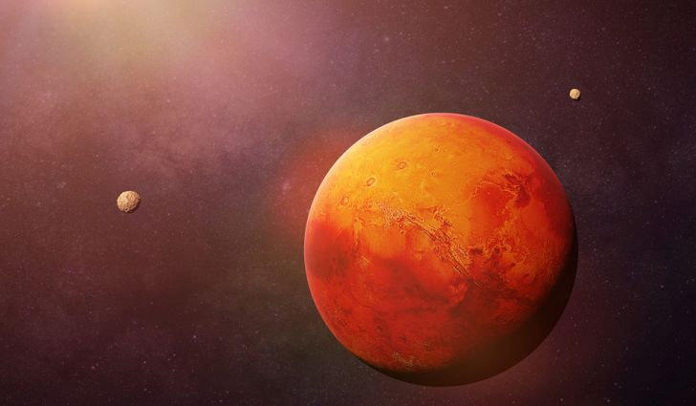
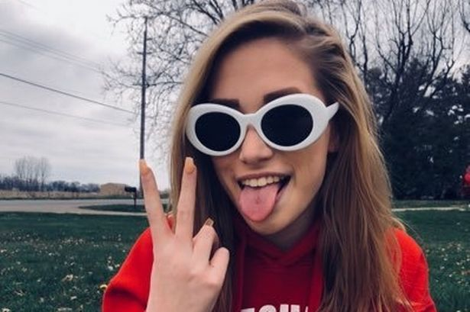
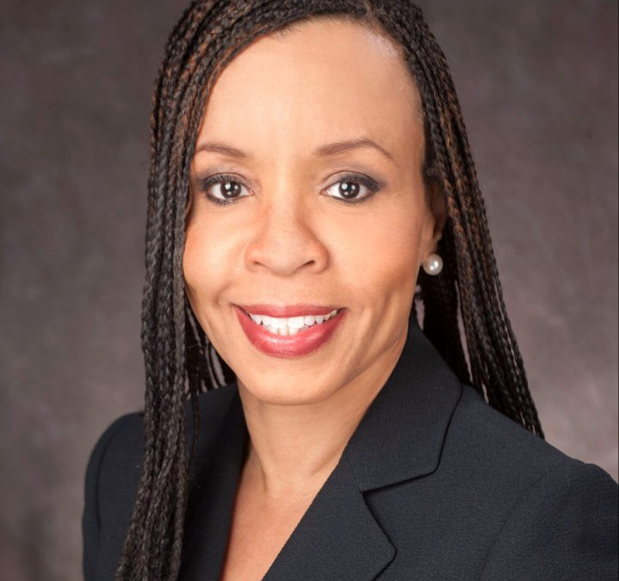
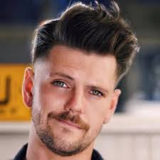
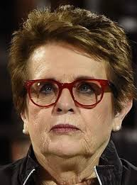
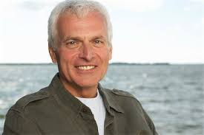
Mission to mars
By: Donato Caputo, Ben Schwartz, Sybil Thomas. Annabelle Whitehead, Ava Wilkie, and Maggie Welp

Slide 2
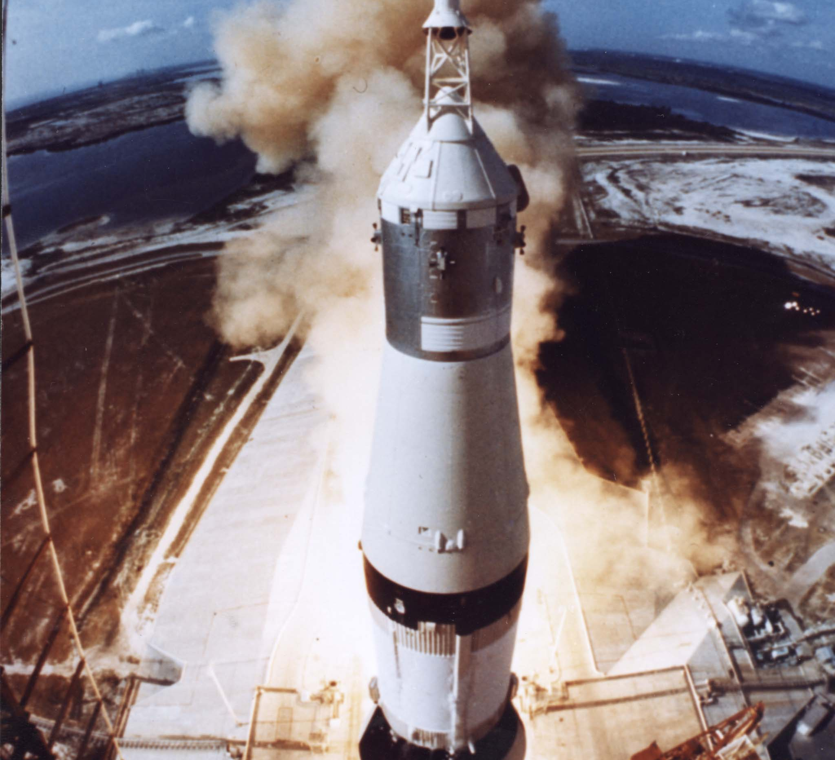
Our crew name is the Genevieve 11.

Slide 3
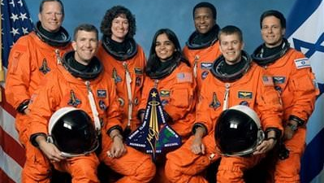
Space Team Members
Miles Bernard
Rebecca Johnson
Elijah Johnson
Brenda Davis
Meredith Anderson
Sophia Lawrence
Roger Trudelle
This Photo by Unknown author is licensed under CC BY-NC-ND.

Slide 4
Sophia lawrence
Sophia Lawrence is an excellent candidate for the Mars mission. Why? Because, she is an ER doctor and will be a big help in space If someone gets injured or sick. Although she has cancer and only has a few years left, she can spend her last years on Mars and if she dies while she's there then she can be honored as the first person to die on mars. Sophia is an optimist, so she has a more positive outlook.
This Photo by Unknown author is licensed under CC BY-NC-ND.
This Photo by Unknown author is licensed under CC BY-NC-ND.

Slide 5
Rebecca Johnson
Our group chose Rebecca Johnson because of her knowledge in computer sciences. Rebecca Johnson is only 31, and she is in good health. Rebecca is an optimist, so she also has a positive outlook. Rebecca is an extrovert, so we can infer that she works well with large groups. Rebecca is a widower with 1 son, Elijah.

Slide 6
Elijah Johnson
Elijah is a very smart 3rd grade student. Elijah has an I.Q of a 170, and Elijah is in excellent health. Elijah's mom is Rebecca Johnson, whom is also going on the exploration to Mars. Although Elijah is a little young, we think that Elijah will make a great candidate. Elijah has a positive outlook because he is an optimist.

Slide 7
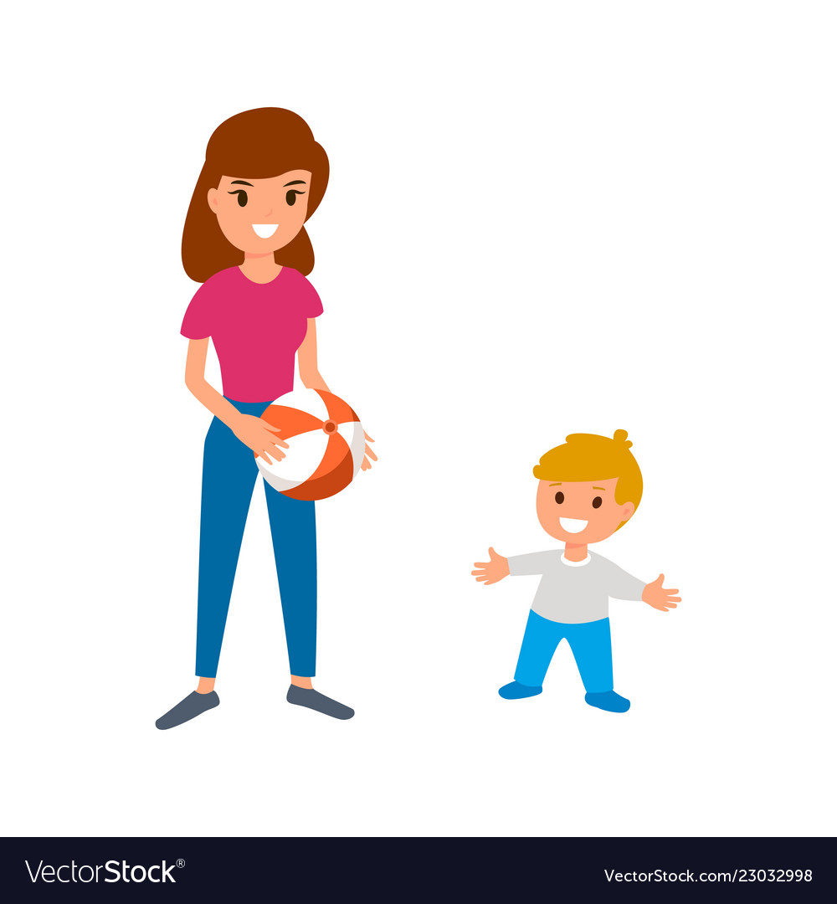
Meredith Anderson
Since we are bringing Elijah, he will need someone to watch over him while he helps on the ship. Meredith is motivated by herself so she will be a good addition to the crew. She has an IQ of 120 and her health is excellent. She has been a babysitter for 2 years, and she is optimistic.
This Photo by Unknown author is licensed under CC BY-SA.
This Photo by Unknown author is licensed under CC BY-SA.

Slide 8
Brenda davis
Brenda is a good candidate for the MArs trip. She can help with any stress caused problems that could occur on board. Brenda's health is fair besides her slight heart murmur. Brenda is an introvert which is not the greatest quality, but she has an I.q of 140 which could benefit the mission.

Slide 9
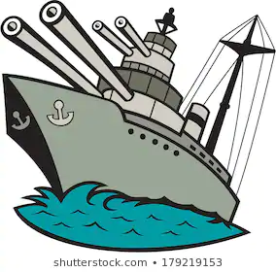
Miles Bernard
Miles Bernard is a very smart 54-year-old man. He is highly trained in electronics and has been in the navy for 25 years. He has also been a private sector for 10 years. He is in excellent health so there is a lesser chance of him dying on Mars. Since he is older, he has more wisdom and he is optimistic.

Slide 10
Roger trudelle
Roger Trudelle is a great candidate to bring to Mars because how works with oil rigs. On mars there is oil on the surface, so it is important to have someone who knows how to work with oil. Also Roger is an Optimist , Extrovert, and Intrinsic. Roger has excellent health. He does have 2 kids, but his wife can stay home with them and take care of them. Therefore we should pick Roger Trudelle.

