Slide 1
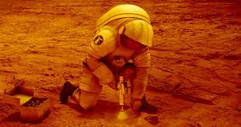
Trip To Mars Project
By: Jailyn Davila, Drew Flower, Mariann Hernandez- Cruz, and Patrick Truong

Slide 2
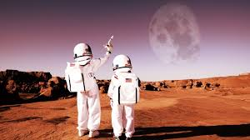
The name of our team is...
Bring the Child To Mars!

Slide 3
About the trip
WE are going to send 7 people to mars
We chose the crew with the highest possible chance of surviving
The trip will last a total of 24 months, 8 months to travel to mars, 8 months to stay on Mars, and 8 months to get back
We are sending...

Slide 4
Rebecca Johnson
Age: 31
Has a PhD in Computer science
She was a professor for 3 year
Extrinsic
An optimist
An extrovert
Her relationship status is a widow, but she has a child, Elijah Johnson
She can help the rocket ship because she is a computer science.

Slide 5
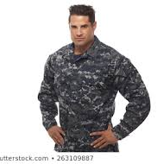
Miles Bernard
Age: 54
He is highly trained in electronics
He was in the navy for 25 years
10 years as a private sector
He was Divorced twice/ Remarried (no children)
He can help fix stuff in the rocket ship because he is trained in electronics

Slide 6
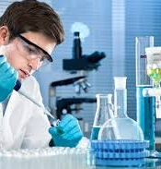
David Greenbow
He is 33
125 IQ
Has a master's degree in chemistry
Worked 10 years as a chemistry teacher
Extrinsic
A pessimist
An introvert
He is married with 2 kids, his wife is pregnant
He can analyze new stuff on mars and help combining molecules together to make air.

Slide 7
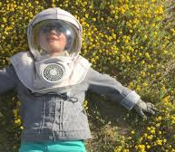
Elijah Johnson
His IQ is immeasurable!
He likes people
He has no relationships except for his mom
He thinks positively
We need elijah because his IQ is very high. He can calculate the course of path of the rocket ship and amounts of food and water.

Slide 8
Sophia Lawrence
39
145 IQ
She has a medical degree
Worked as an ER doctor for 9 years
She is Married and has a child of 6 months
She will help if someone is injured

Slide 9
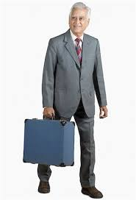
Robert Lindquist
60 years old
IQ of 127 with good health
Has a business degree and has been bank president for 30 years
Married for 39 years
3 kids
8 grandchildren
We are taking him because he can manage the supplies because he was a bank president

Slide 10
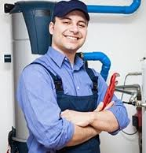
Michael Hanson
Age: 45
Can help with the water system on mars.
Has fair health
Is smart
He is good with people
Michael Hanson is vital to fixing the things that have to do with water on the ship and on mars.

Slide 11
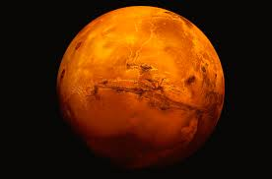
Good Luck Team!
a ha ha

